Slide 1

PRESENTATION ON : ‘identifying associative risk in stock market’
STUDENT DETAILS :
Mayank Baluni
Roll No. : 2021892
MENTOR NAME :
Dr. Jay Bhatnagar, Professor

Slide 2

Risks in stock market
Risk, in the context of financial markets, refers to the uncertainty and probability of financial loss. Markets are influenced by a myriad of factors, including economic indicators, geopolitical events, market sentiment, and technological advancements. The interconnected nature of global financial systems means that risks can emanate from various sources and impact different asset classes.

Slide 3

ASSOCIATIVE RISK in stock market
Associative risk, as expressed through correlation, is a crucial element in the risk landscape of the stock market. Investors who grasp the intricacies of how different assets move in relation to each other can make more informed decisions and construct portfolios that align with their risk tolerance and investment objectives. By incorporating strategies such as diversification, correlation analysis, and dynamic asset allocation, market participants can navigate associative risk more effectively and strive for a more resilient and balanced investment portfolio

Slide 4

What is correlation?
The correlation between the activity of two stocks can be a very important factor in developing a prudent investing strategy.
Stock analysts use the correlation coefficient to measure both the degree and direction of the correlation between any two stocks.
The correlation coefficient can be anywhere between -1 and 1, though it is almost always in between. A coefficient of 0 indicates no relationship whatsoever.
The correlation coefficient can be used to select stocks in different industries that tend to move in tandem, or to select stocks with a negative coefficient so that if one stock fails, the other is likely to get a boost.

Slide 5
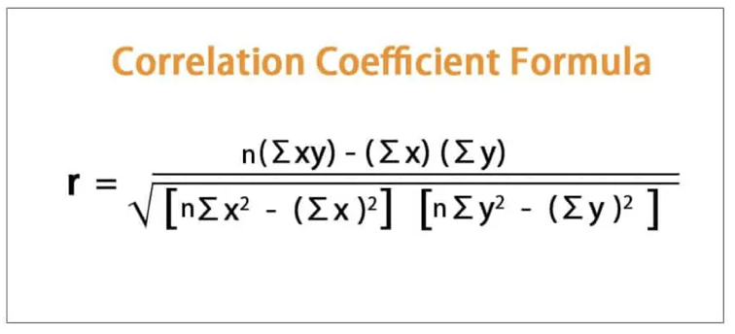
Formula to calculate correlation coefficient

Slide 6

three trends of correlation
In the world of stocks, a positive correlation describes a relationship where two individual stocks tend to move in the same direction. This means that when one stock price goes up, the other one also tends to increase, and vice versa.

Slide 7
three trends of correlation
The correlation coefficient falls between -1 and 0. A value closer to -1 indicates a stronger negative relationship.
Two stocks with a negative correlation move in opposite directions. When one stock price rises, the other tends to fall, and vice versa.

Slide 8
three trends of correlation
The correlation coefficient is 0.
Two stocks with zero correlation have no discernible relationship in their price movements. The change in one stock's price does not provide any information about the likely direction of the other stock.

Slide 9
UNDERSTANDING THE CODE
import openpyxl
import numpy as np
import matplotlib.pyplot as plt
def extract_values_from_sheet(sheet, k, column):
values_range = sheet[f'{column}2:{column}{k}']
return [cell.value if cell.value is not None else 0 for row in values_range for cell in row]
def calculate_correlation(sheet1, sheet2, k, column):
values_list1 = extract_values_from_sheet(sheet1, k, column)
values_list2 = extract_values_from_sheet(sheet2, k, column)
correlation_coefficient = np.corrcoef(values_list1, values_list2)[0, 1]
return correlation_coefficient
def process_correlation(columns):
wb1 = openpyxl.load_workbook("Reliance Dataset.xlsx")
wb2 = openpyxl.load_workbook("Adani Dataset.xlsx")
sheet_names = [f'week {i}' for i in range(1, 14)]
k = 6

Slide 10
all_weekly_coefficients = [] for sheet_name in sheet_names: if all(sheet_name in wb.sheetnames for wb in [wb1, wb2]): weekly_coefficients = [] for col in columns: sheet1 = wb1[sheet_name] sheet2 = wb2[sheet_name] correlation_coefficient = calculate_correlation(sheet1, sheet2, k, col) weekly_coefficients.append(correlation_coefficient) all_weekly_coefficients.append(weekly_coefficients) k += 5 else: print(f"Sheet {sheet_name} not found in one or both workbooks.") return all_weekly_coefficients # Process different columns columns_to_process = ['B', 'C', 'D', 'E']

Slide 11
weekly_coefficients = process_correlation(columns_to_process) for week, coefficients in enumerate(weekly_coefficients, start=1): print(f"Week {week} Correlation Coefficients: {coefficients}") # Plotting week_numbers = list(range(1, 14)) column_labels = {'B': 'Open', 'C': 'Max', 'D': 'Min', 'E': 'Closing'} for col in columns_to_process: correlation_values = [coefficients[columns_to_process.index(col)] for coefficients in weekly_coefficients] plt.plot(week_numbers, correlation_values, label=column_labels[col]) plt.title('Correlation Coefficients Over Weeks') plt.xlabel('Week') plt.ylabel('Correlation Coefficient') plt.ylim(-1, 1) # Set y-axis limits to vary between -1 and 1 plt.xticks(week_numbers) # Set x-axis ticks to represent weeks 1 through 13 plt.legend() plt.grid(True) plt.show()

Slide 12
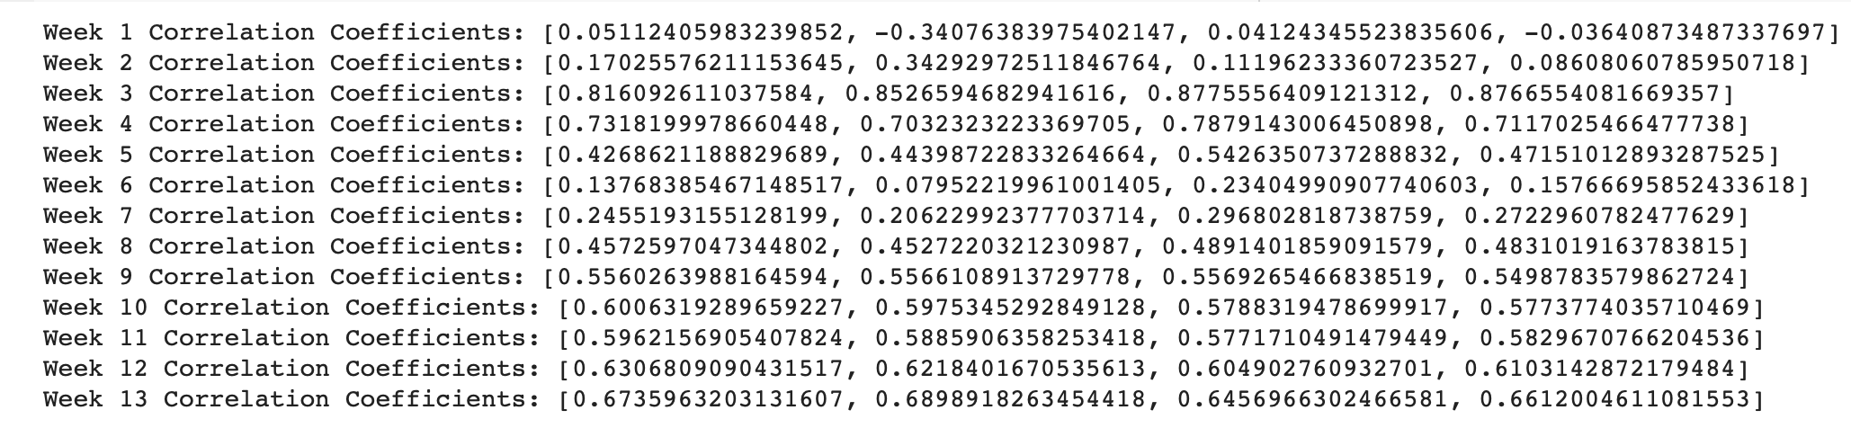
Output of code

Slide 13
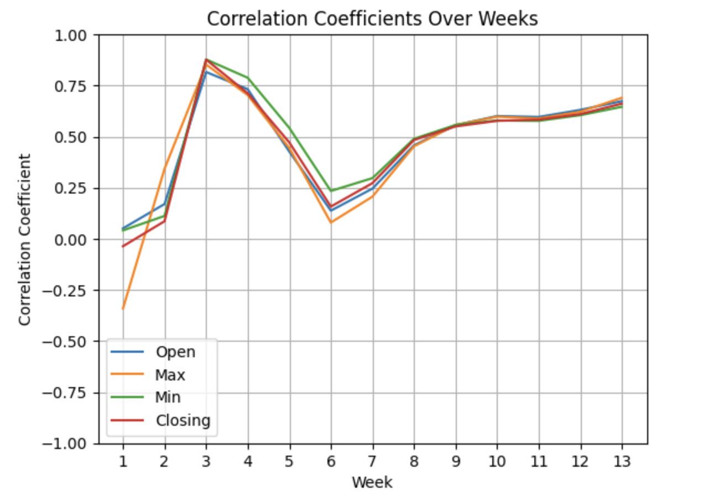
Output of code

Slide 14
Results and discussion
We’ve used stocks of Adani Enterprises and Reliance Industries in our dataset, and we got 4 correlation coefficients for 13 weeks of data and plotted a graph between correlation coefficients and their subsequent weeks.
Where we saw we got a positive trend of correlation, that means there are no risks associated with the two stocks we considered.

Slide 15

APPLICATIONS
Diversification:
If the correlation coefficient between two stocks is close to +1, it indicates a strong positive correlation. This means that the two stocks tend to move in the same direction. In such cases, adding both stocks to a portfolio may not provide effective diversification, as they are likely to respond similarly to market fluctuations. Investors often seek stocks with low correlation to diversify their portfolio, reducing overall risk. Diversification is a strategy that mixes a wide variety of investments within a portfolio in an attempt to reduce portfolio risk.
Risk Management:
Conversely, if the correlation coefficient is close to -1, it indicates a strong negative correlation. This means that the two stocks move in opposite directions. Including negatively correlated stocks in a portfolio can help mitigate risk. When one stock is underperforming, the other may be performing well, providing a potential hedge against losses.
Portfolio Construction:
Investors can use correlation coefficients to construct portfolios that align with their risk tolerance and investment goals. Combining assets with low or negative correlations can lead to a more stable and less volatile portfolio.

Slide 16
APPLICATIONS
4.Sector Analysis:
Correlation coefficients are not limited to individual stocks; they can also be applied to sectors or industries. Understanding the correlation between sectors helps investors assess the overall market risk. For example, during economic downturns, certain sectors may be negatively impacted, while others may remain resilient.
5.Market Conditions:
Changes in the correlation coefficient between two stocks can provide insights into broader market conditions. For example, during times of market stress or economic uncertainty, stocks may become more correlated as investors react similarly to external events.
6.Forecasting:While correlation does not imply causation, analyzing historical correlations can provide some insights into potential future trends. Investors can use this information to anticipate how changes in one stock might affect another in their portfolio.

Slide 17
THANK YOU

